Slide 1
The role of surface turbulent fluxes in air-sea INTERACTIONS: Boundary layer – convection coupling across the tropical oceans
Candidate: Alessandro Storer
Panel: Hans Segura, Juan Pedro Mellado
Expected PhD mandate: September 2025 – September 2028

Slide 2

Academic formation and current activity
2019
BSc. in Physics
University of Milan
2022
MSc. in Environmental Meteorology
University of Trento - University of Innsbruck
2024
Junior research assistant
University of Milan Bicocca – sup. Prof. Claudia Pasquero
One proceeding (accepted, ASR) and one full article (under rev., QJRMS)
08.2025
09.2025
PhD candidate
Scale Interaction Modelling group – sup. Dr. Hans Segura
prof. Juan Pedro Mellado

Slide 3
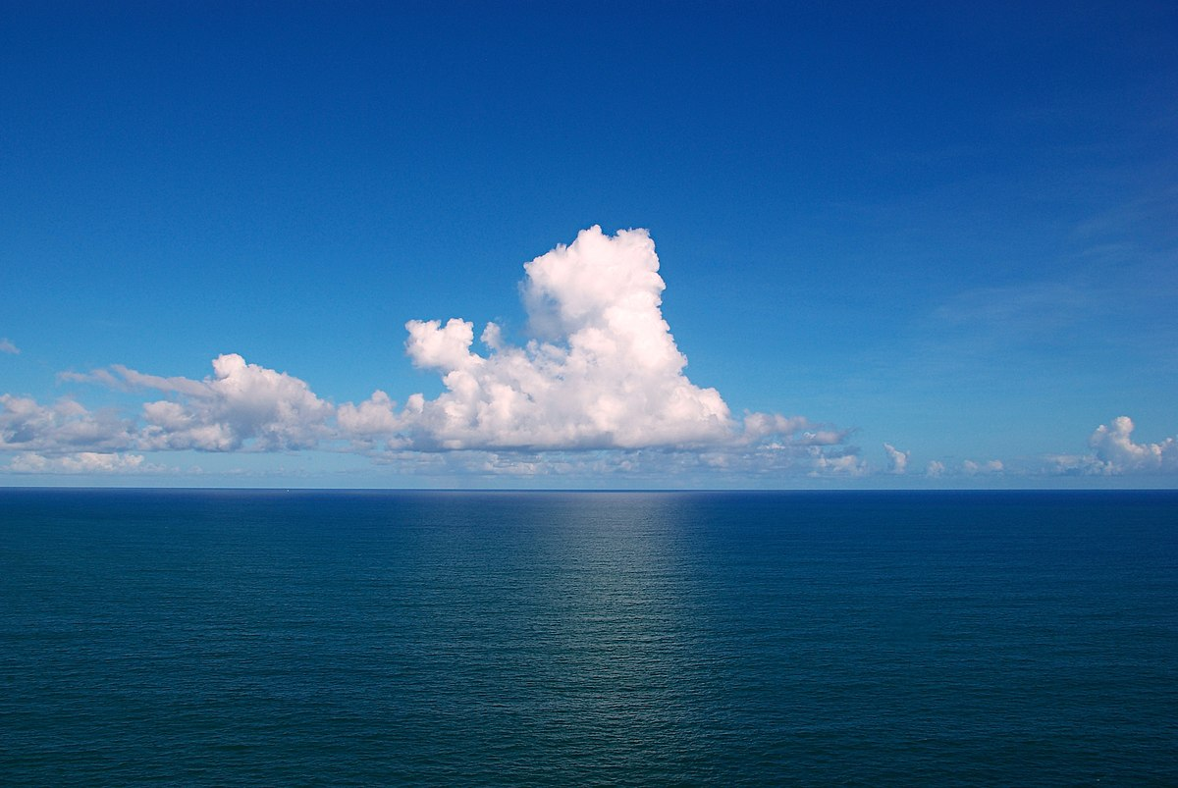









































Boundary Layer Top
Turbulent fluxes
$$S_{H} , S_{q}$$
SST’ < 0
SST’ > 0
Notes:
the coupling between marine shallow
trade-wind clouds and circulation is known to play a cen-
tral role in the uncertainty of the tropical cloud feedback and climate sensitivity estimated by models

Slide 4






























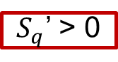







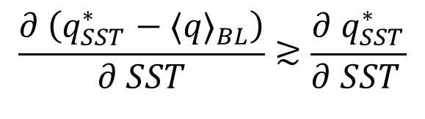







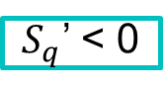



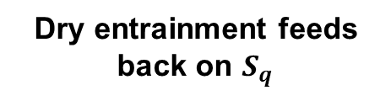


Summary schematics
Thermodynamic adjustment over daily timescales
BL Top ’
Dry entrainment feeds
back on $S_{q}$
$$\frac{∂ \left(q_{SST}^{∗}−{⟨q⟩}_{BL}\right)}{∂ SST}≳\frac{∂{ q}_{SST}^{∗}}{∂ SST }$$
$S_{q}$’ < 0
$S_{q}$’ > 0
Small-scale SST variability
dominates LHF variance
and excites non-linear
upscaling effects
SST – Entrainment coupling is scale-dependent
Representative mechanism in range
100 – 400 km
SST’ < 0
SST’ > 0
Air temperature
Air turbulence
moisture

Slide 5
Now, with this acquired knowledge…

Slide 6
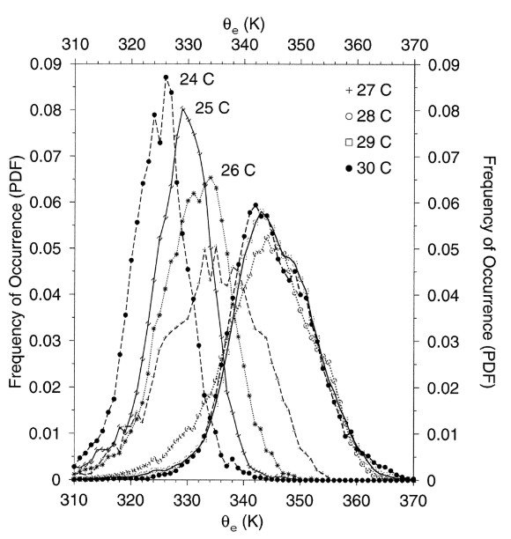
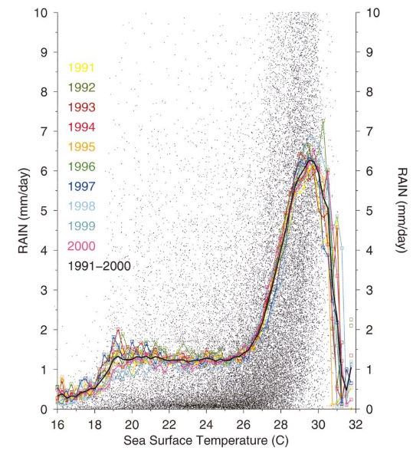
tropical precipitation…
Ian and Braun, 2002

Slide 7

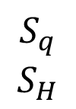

…And Boundary layer quasi-equilibrium
Cycle happening typically over 0.5 days (Raymond 1994)
MABL
Study area: Warm Pool region i.e. high SST, light winds , low SST gradients
$$S_{q}$$
$$S_{H}$$
$$\frac{D}{Dt}h≈Q_{RAD}+S_{H}+S_{q}+ε$$
Warm tropical ocean
h
Notes:
Free-tropospheric MSE is constant along pseudo-adiabats

Slide 8
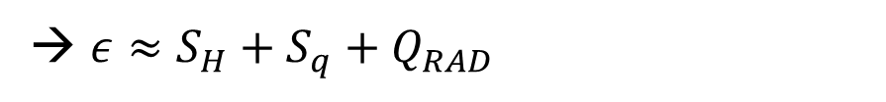
What to do? – Initial numerical study
Suitable definition of boundary layer → there are many!
MSE budget analysis over longer-than-convective timescales (steady state)
→ $ε≈S_{H}+S_{q}+Q_{RAD}$
Assess the full time-dependent evolution of MSE to characterize:
Comparison between precipitating and non-precipitating regions → when is convection exactly triggered?
Role of downdrafts and related gustiness → interaction of different scales of variability

Slide 9
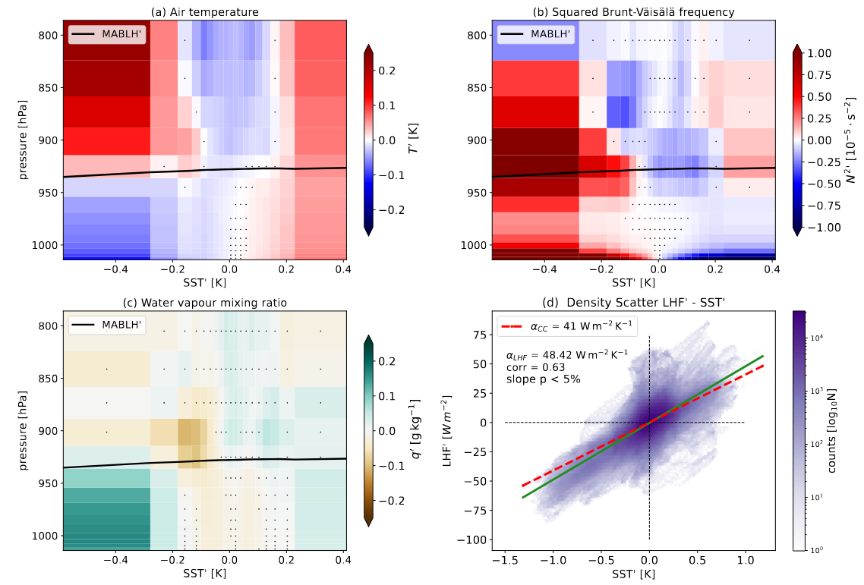
mesoscale Air column adjustments
EUREC4A region February 2020
High-res. WRF simulations
c) Fixed scales of interest
< ~200km
→ correlate SST’ with
atmospheric ones
d) SST – Entrainment coupling

Slide 10
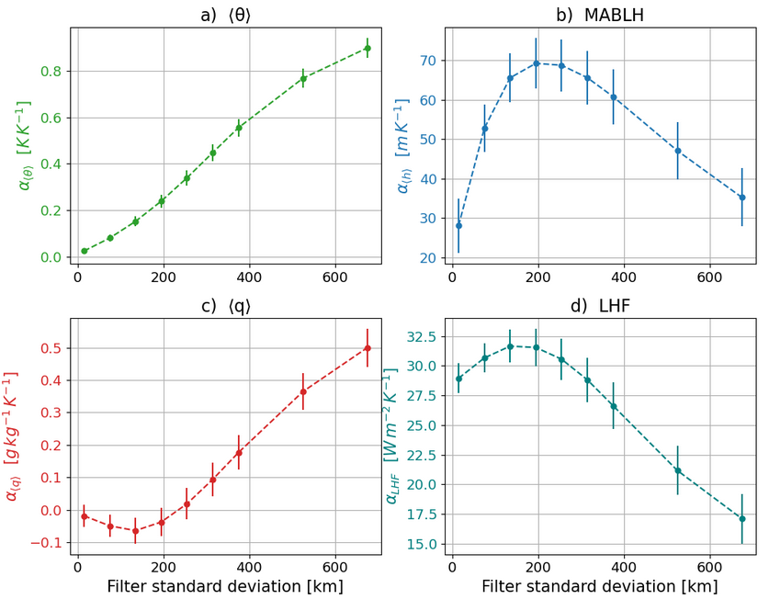
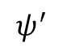
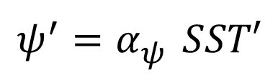
Scale-dependent coupling
Atmosphere-only WRF simulation
$$ψ^{′}=α_{ψ}^{} SST′$$
$$ψ^{′}$$
SST’

Slide 11
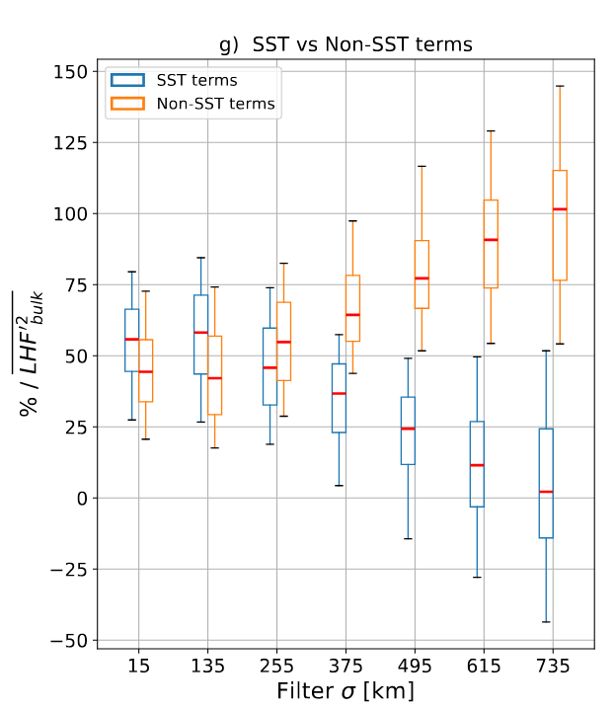
Spatial variability of lhf exchange

Slide 12
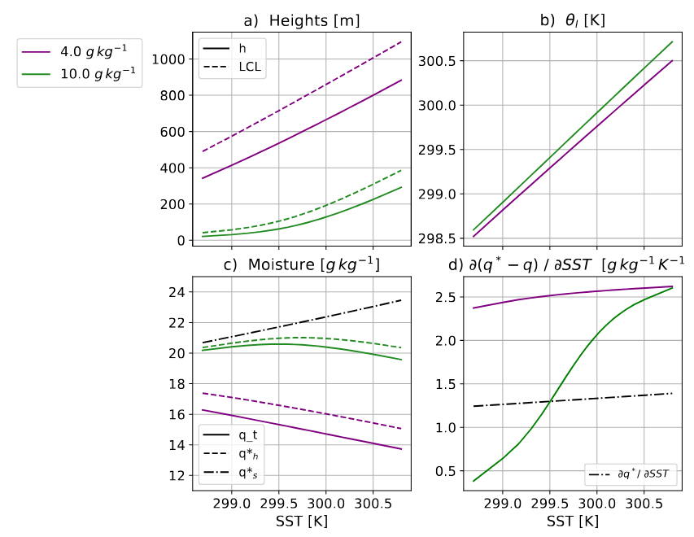
Two conceptual scenarios

Slide 13
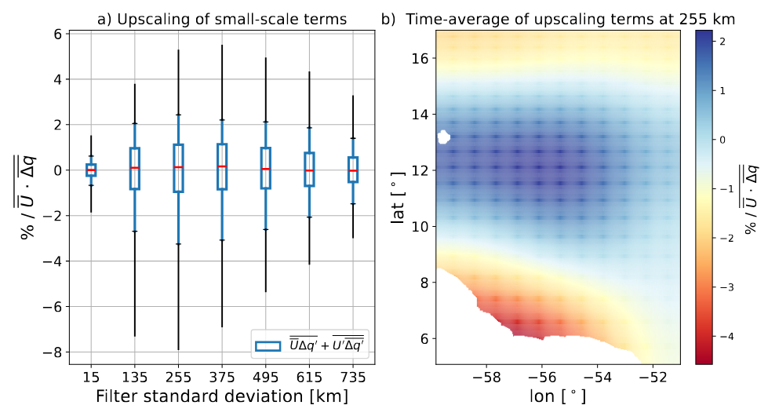

Upscaling effect in LHF modulation

Slide 14
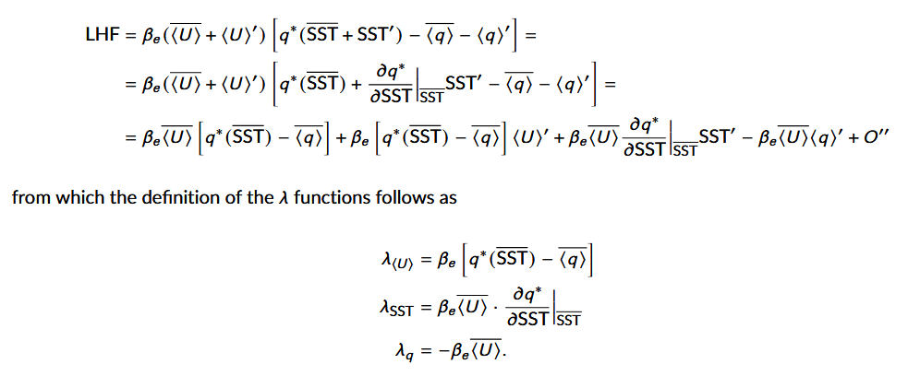
Backup

Slide 15

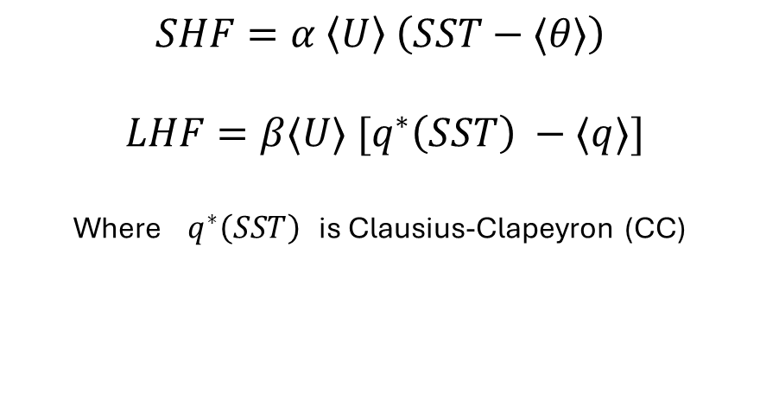
Sensitivity of surface fluxes to SST
MABL
$$SHF=α \left\langle U\right\rangle \left(SST−⟨θ⟩\right)$$
$$LHF=β⟨U⟩ [q^{∗}\left(SST\right) −⟨q⟩]$$
Where $q^{∗}\left(SST\right)$ is Clausius-Clapeyron (CC)
SHF’ ?
LHF’ ?
SHF’ ?
LHF’ ?
$$sensitivities == \frac{∂HF′}{∂SST′}$$
SST’ < 0
SST’ > 0
Notes:
Check how WRF is computing surface fluxes in the coupled simulation

Slide 16



A minimal physics approach
What is the range of validity of this 1D bulk model ?
How does the thermodynamic adjustment change with scales?

Slide 17
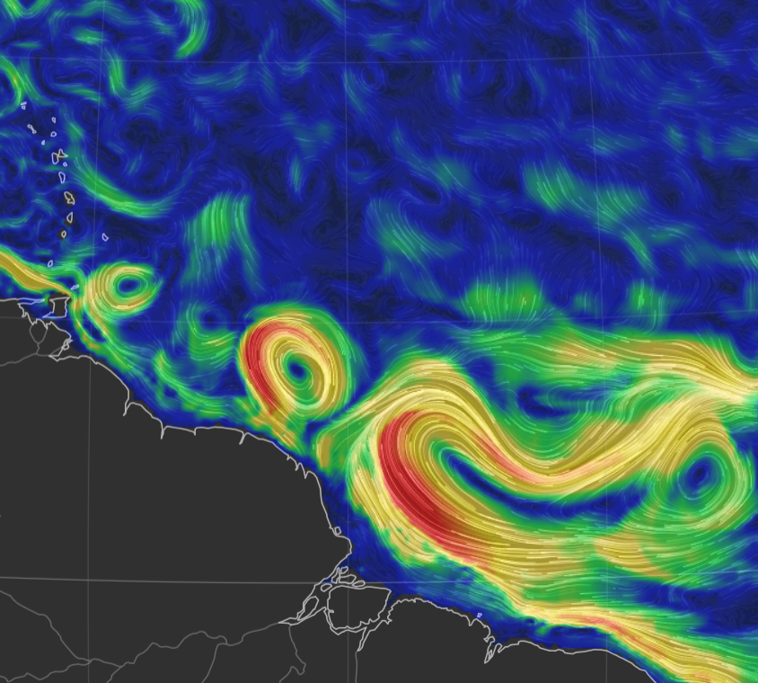

The sub- / mesoscale coupling
Scales < 1000 km are important
in the global energy budget!
(Renault et al. 2023, Seo et al. 2023,
Bishop et al. 2020)
Thermal feedback TFB
Modulates local air temperature, stability and circulation through modified thermodynamic fluxes
(Acquistapace et al. 2022)
How does SST variability act to modulate surface fluxes and hence the lower tropospheric response?
Sea Sfc. currents on 25° Jan 2020
earth.null.school
How does the importance of SST change with scales?

Slide 18
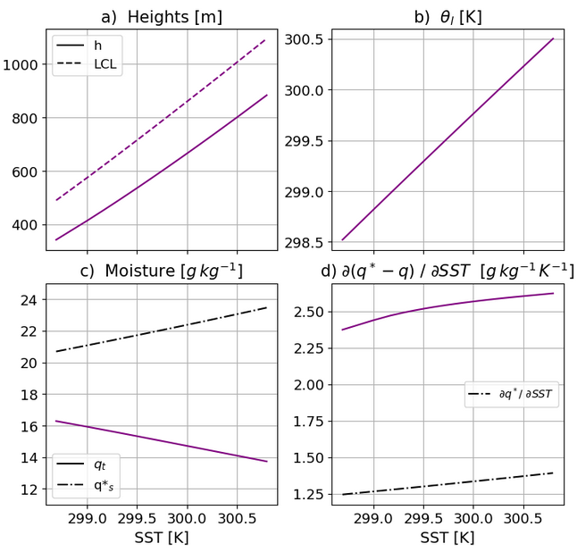
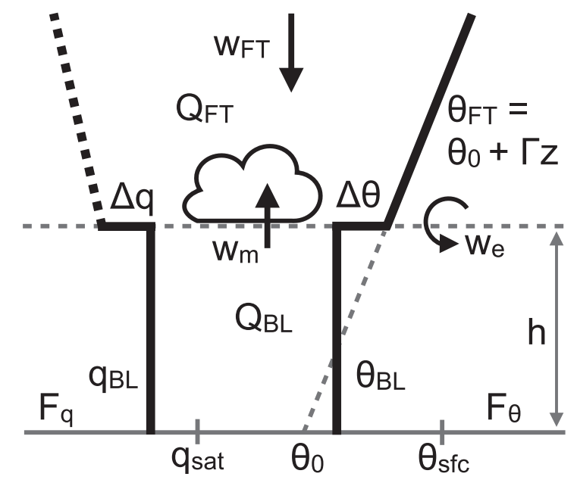
A minimal physics approach
Conceptual Bulk model
starring:
Stevens et al. 2002
Neggers et al. 2006
Naumann et al. 2019

Slide 19
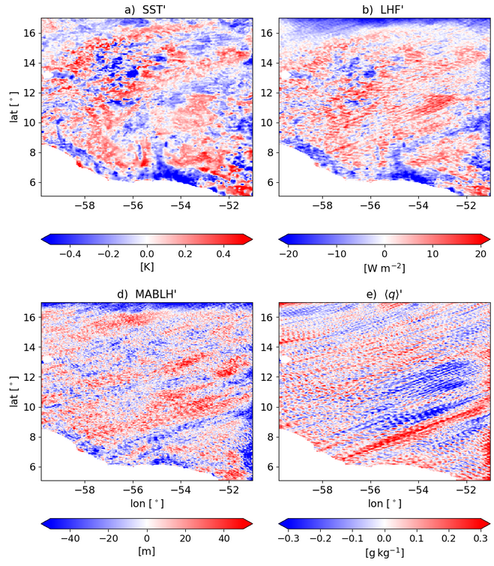
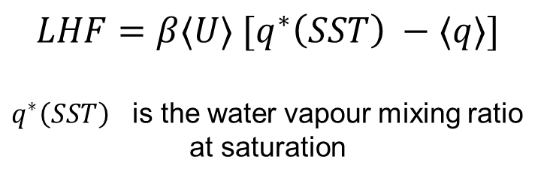
A realistic (complex) set-up
High-resolution WRF simulation:
Gridspace 3km
Daily SST forcing
Daily averages in February 2020
EUREC4A region (Stevens et al. 2021)
$$LHF=β⟨U⟩ [q^{∗}\left(SST\right) −⟨q⟩]$$
$q^{∗}\left(SST\right)$ is the water vapour mixing ratio at saturation

Slide 21
Notes:
Check how WRF is computing surface fluxes in the coupled simulation

